Slide 1

Metering

Slide 2
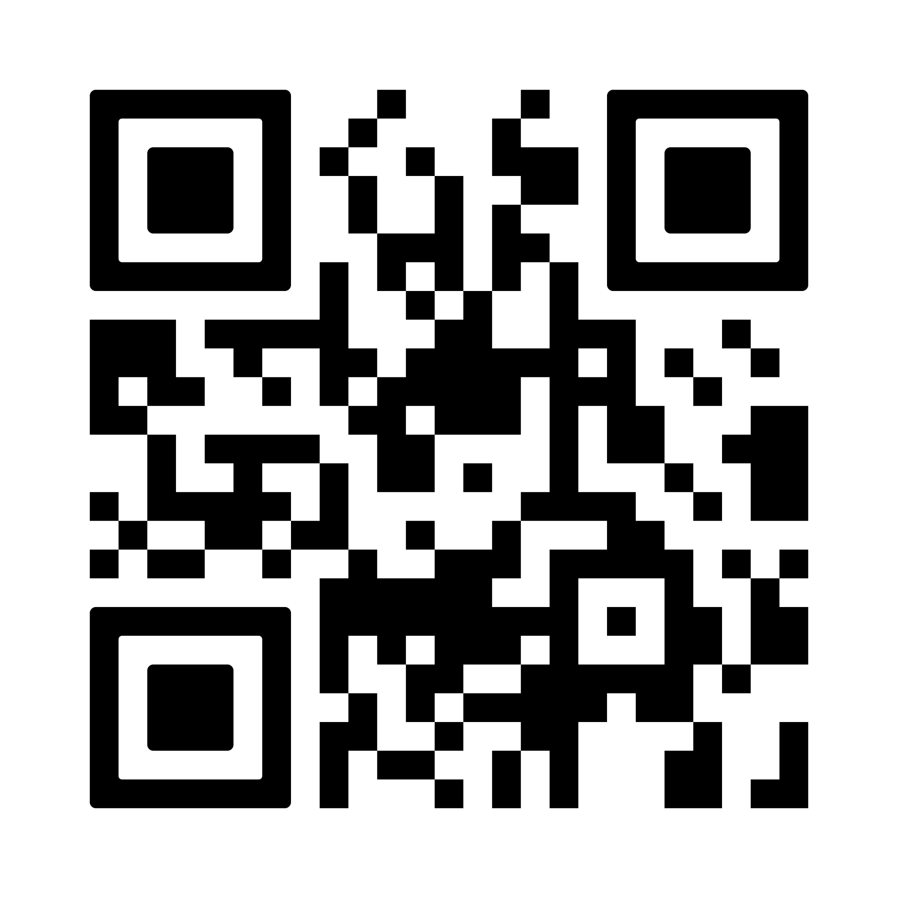
The idea
Learn something involving automations as highschoolers
The process
SCADA (Supervisory Control and Data Acquisition) – Ignition
Virtual Machines –VMware Workstation
Arduino – Uno
PLCs – Siemens S7-1200
Communication Protocols - Modbus + RS232/RS485
Databases - MySQL
Learned how to use all of the mentioned things from the list on the left side of the screen. For example:
We learned how to use Arduino to monitor real-world metrics (primarily energy consumption, but also temperature, humidity and many more)
We learned how to use the Modbus communication protocol to transmit data from one device to another. (master – slave connection)
Created a proper Energy Monitoring System that can be replicated for cheap and is reliable. It is also easily upgradable, having used a lot of very modular and documented programs. (GitHub repository for more details in the QR above)
It was not a process without its difficulties, but it was definitely worth it!

Slide 3
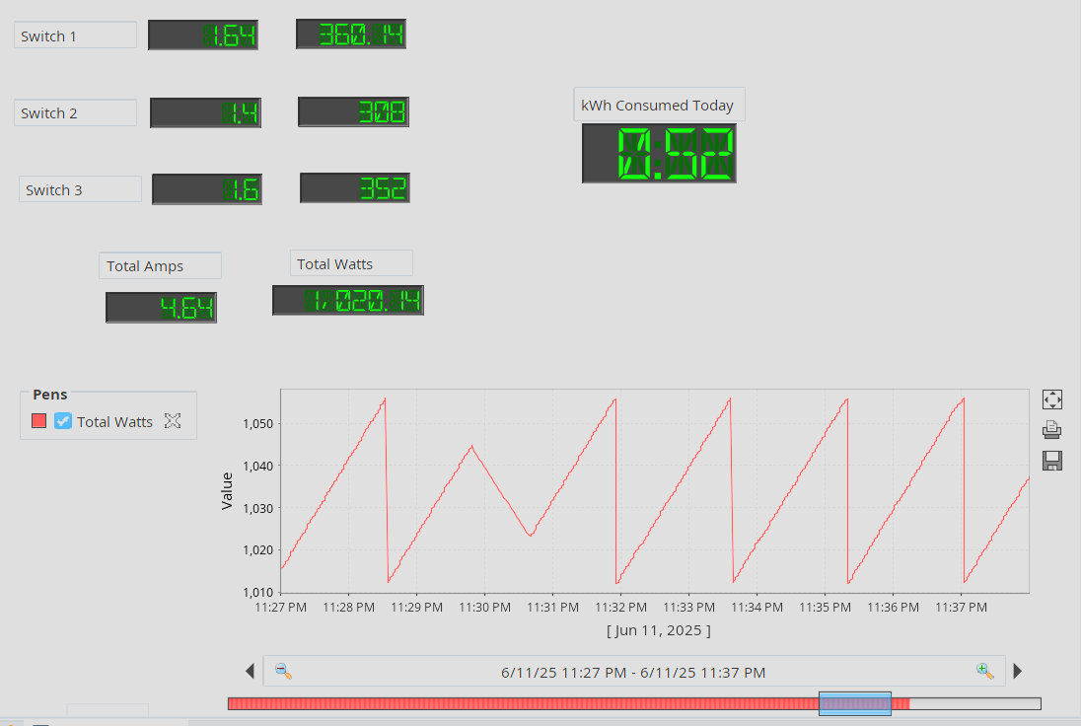
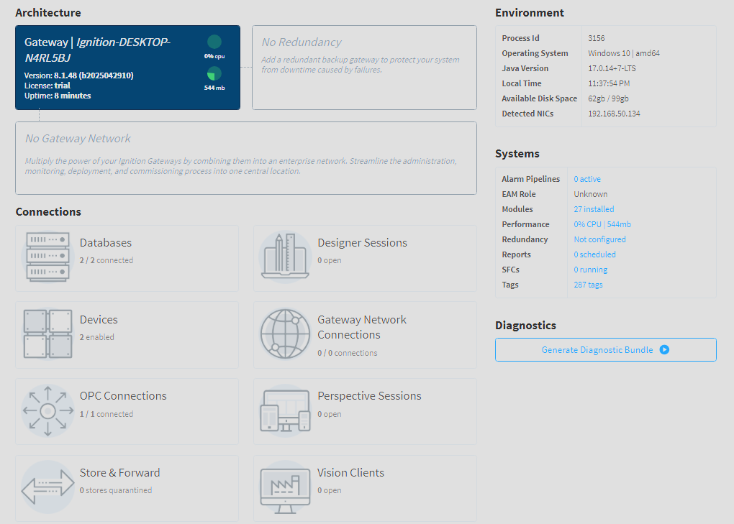
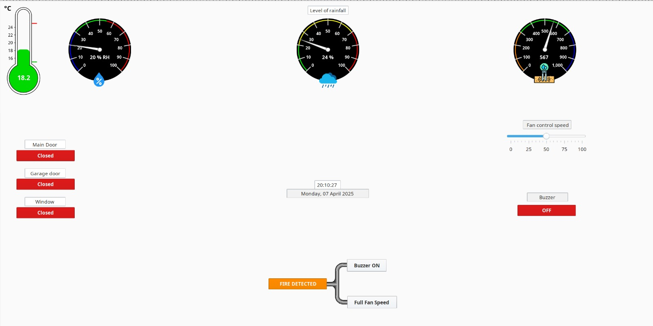
SCADA - Ignition
Energy Monitoring System (Designer)
Gateway Status
Bitmi House UI concept (Designer)

Slide 4
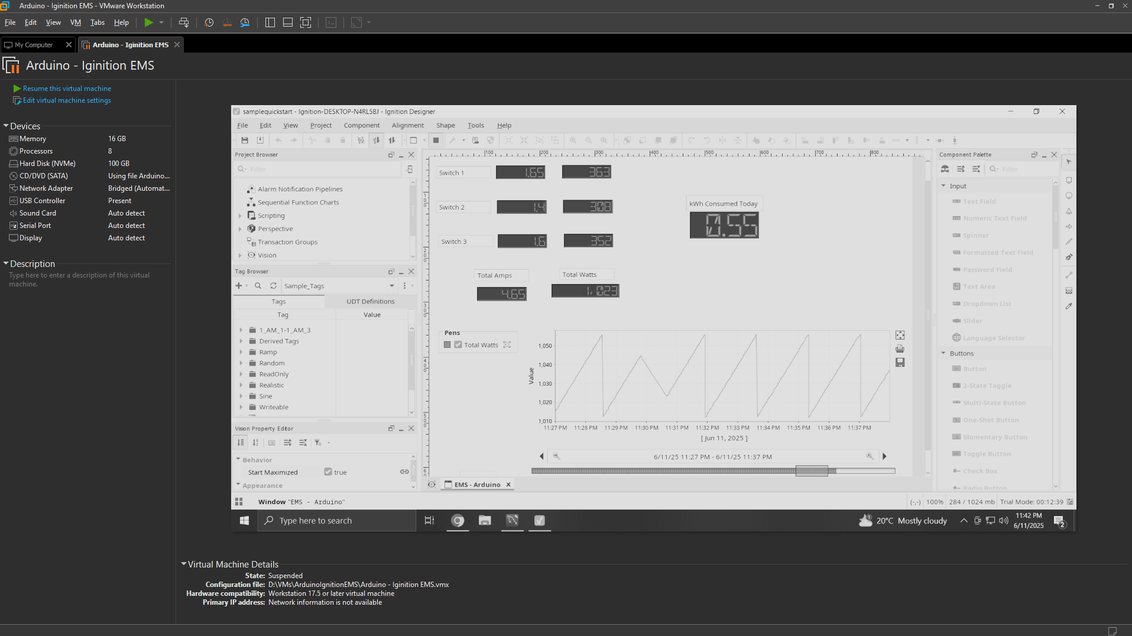
Virtual Machines – VMware Workstation

Slide 5
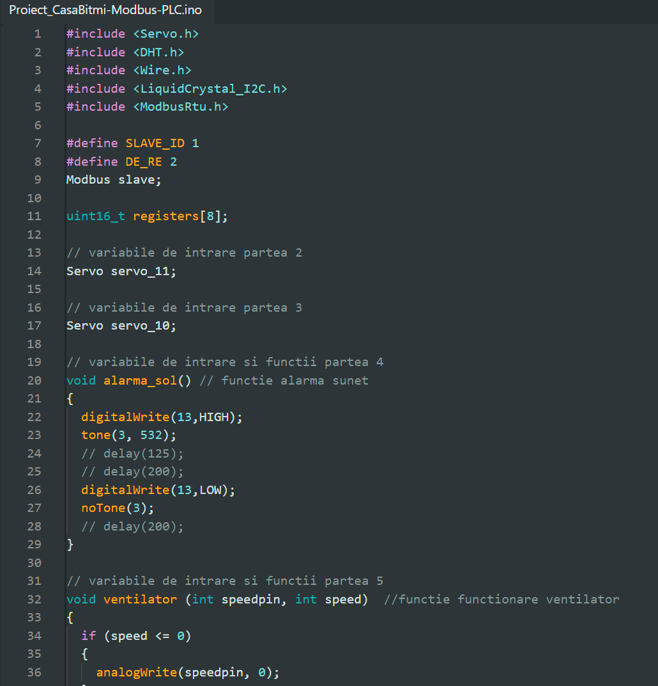
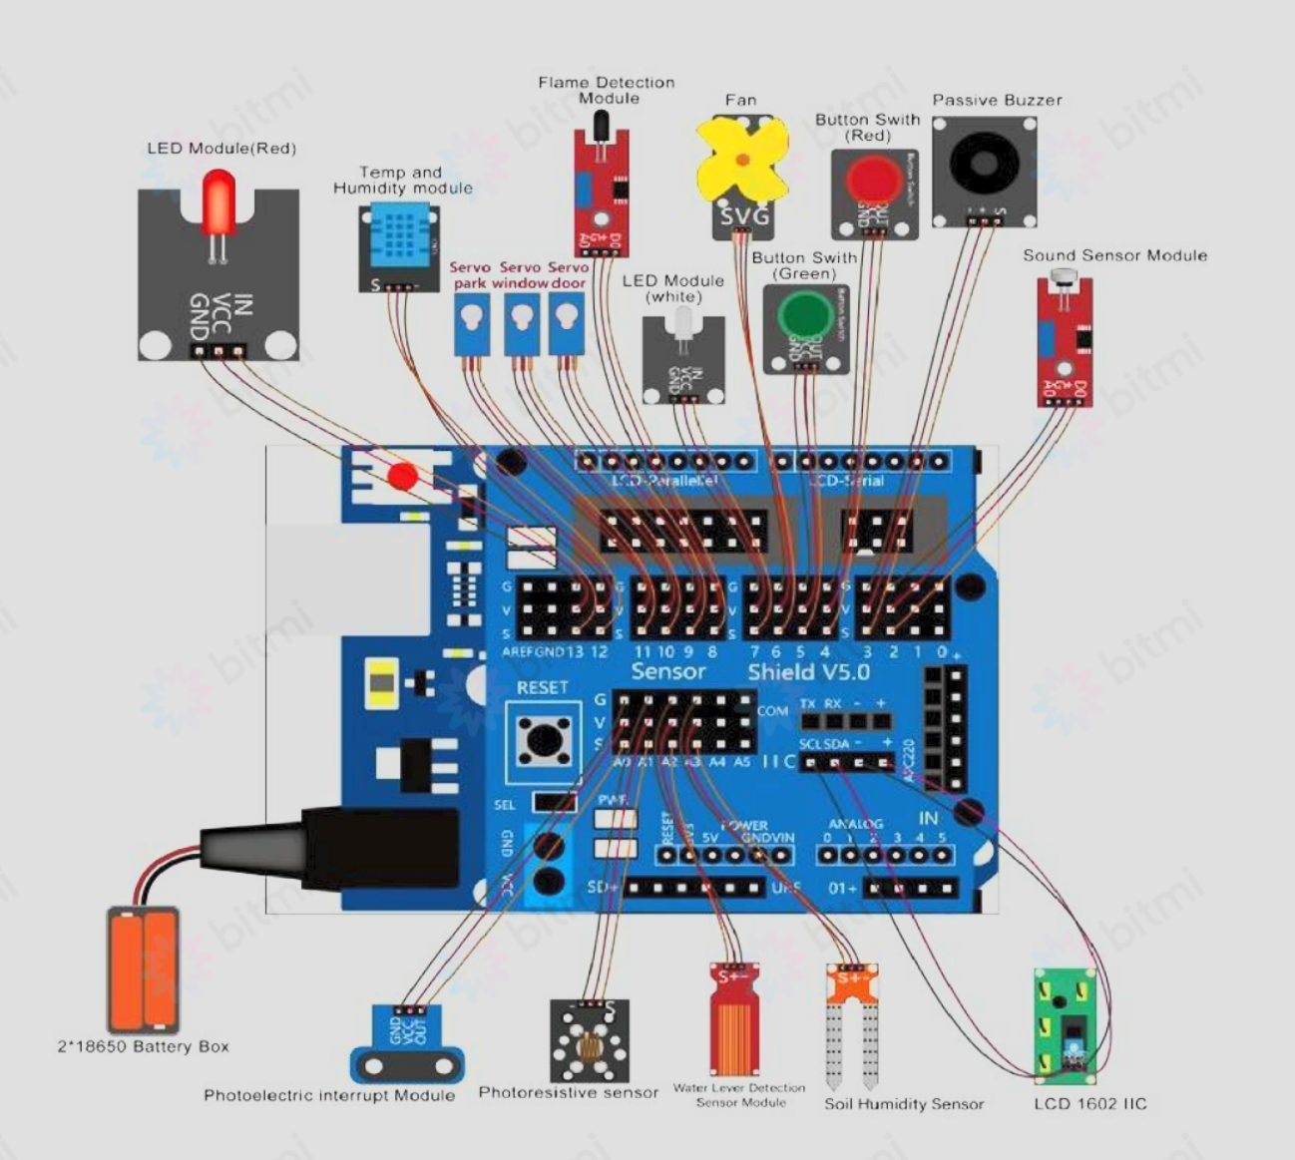
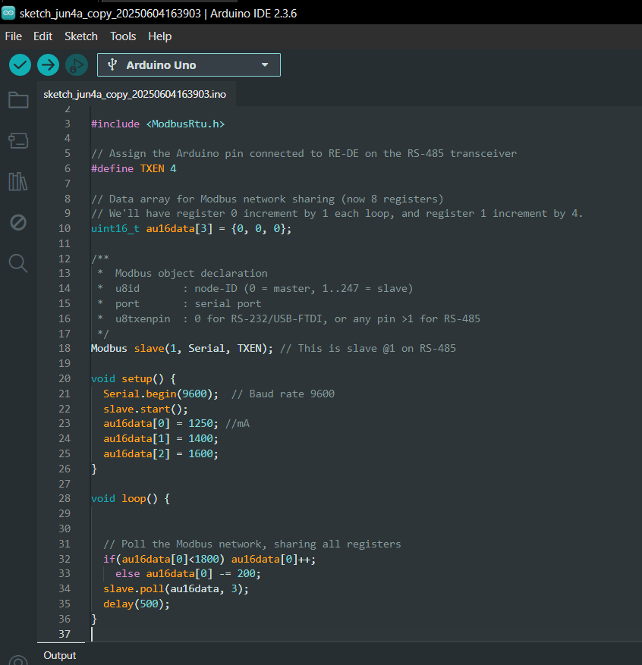
Arduino UNO
EMS - Example
Bitmi House

Slide 6
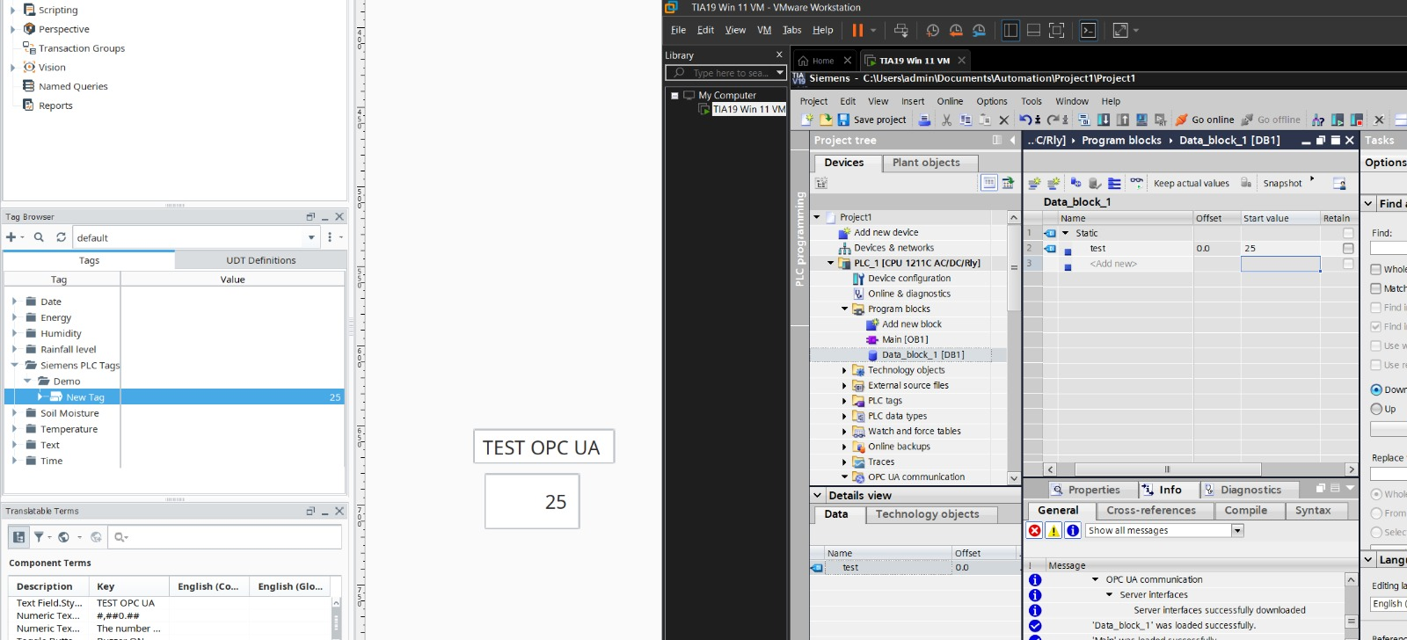
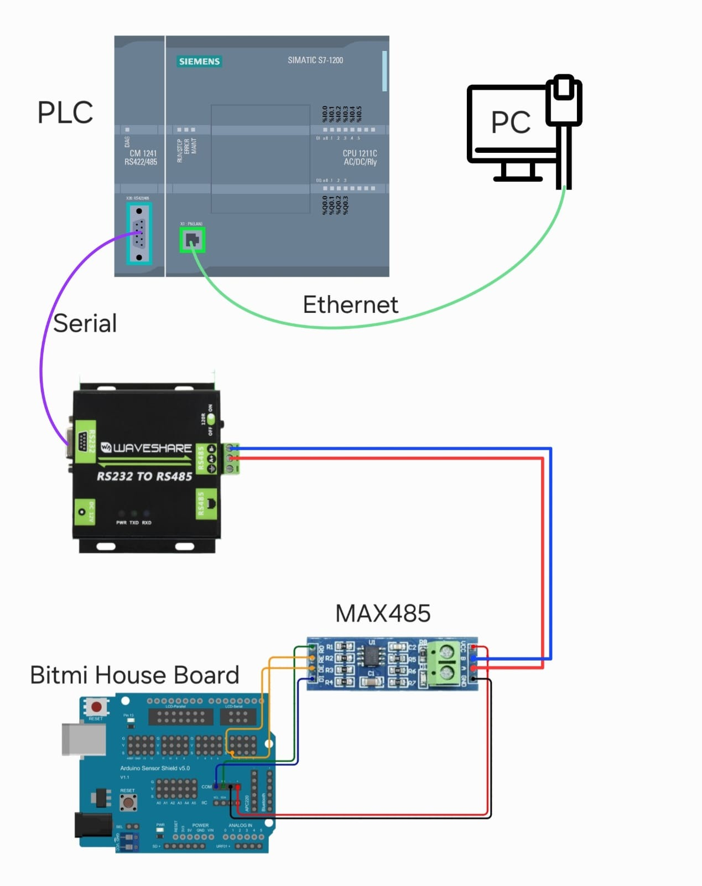
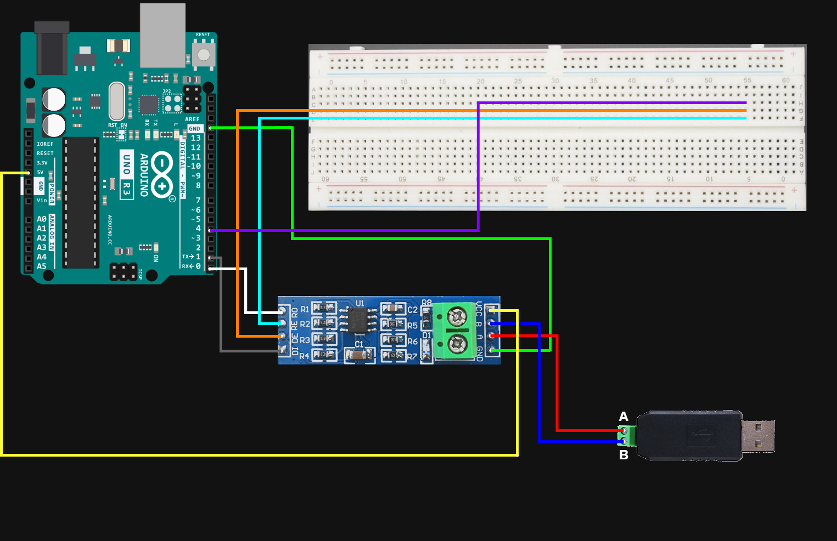
Communication protocols – Modbus + RS232/485
Our Setups

Slide 7
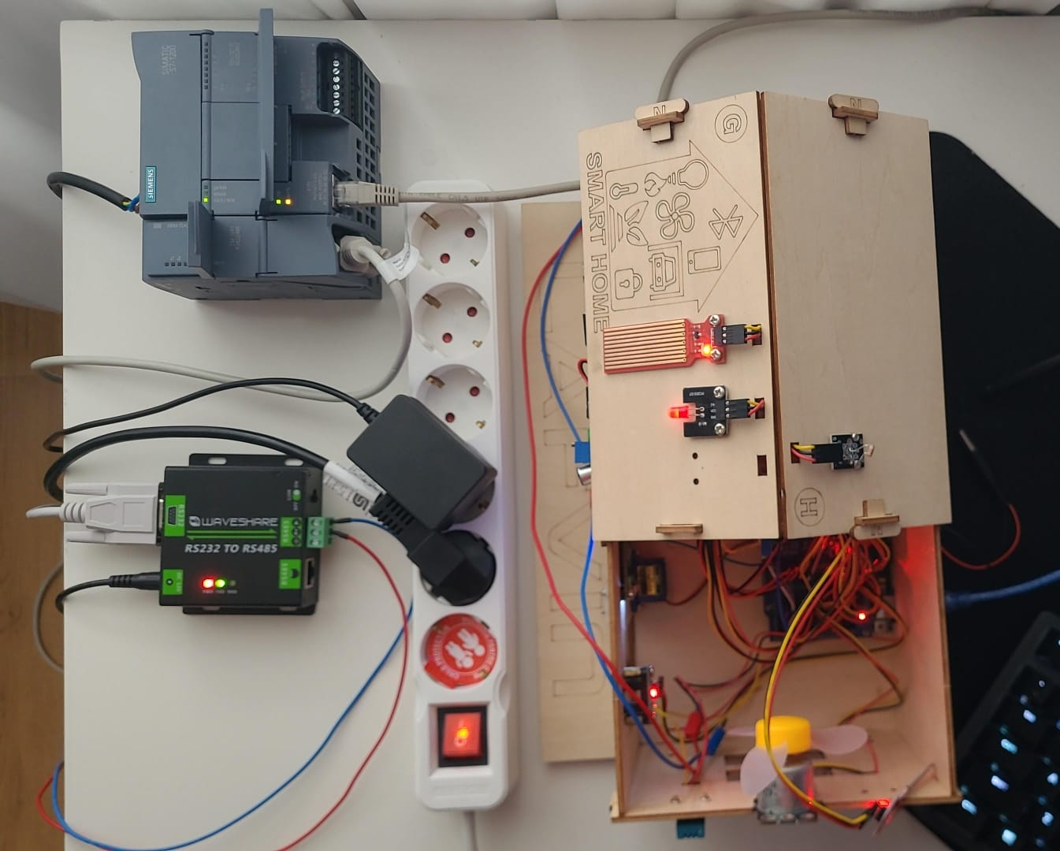
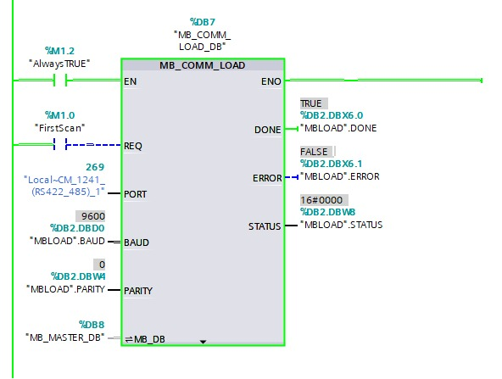
PLC – Siemens S7-1200 (Siemens TIA)
Hardware Used
Siemens TIA Modbus Connection

Slide 8
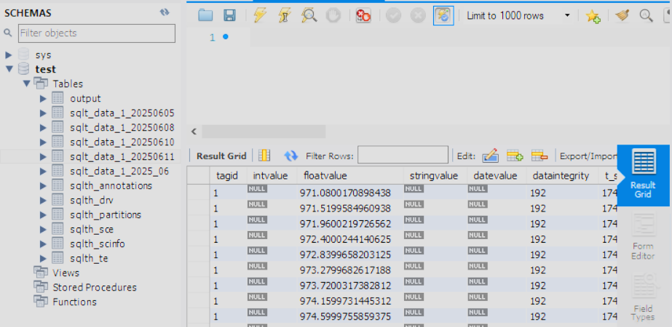
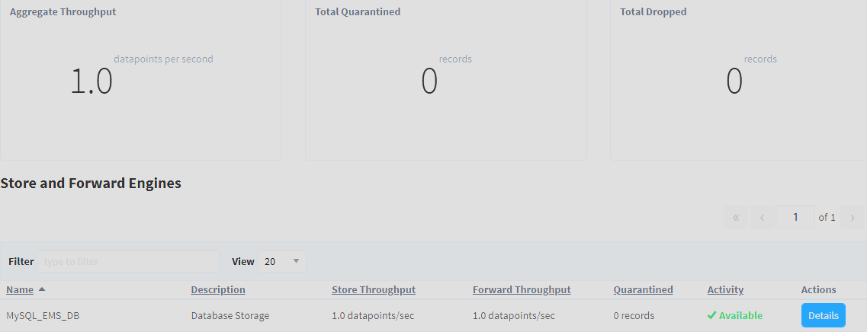
Databases - MySQL
Ignition Gateway (Store & Forward)
MySQL Workbench

Slide 9
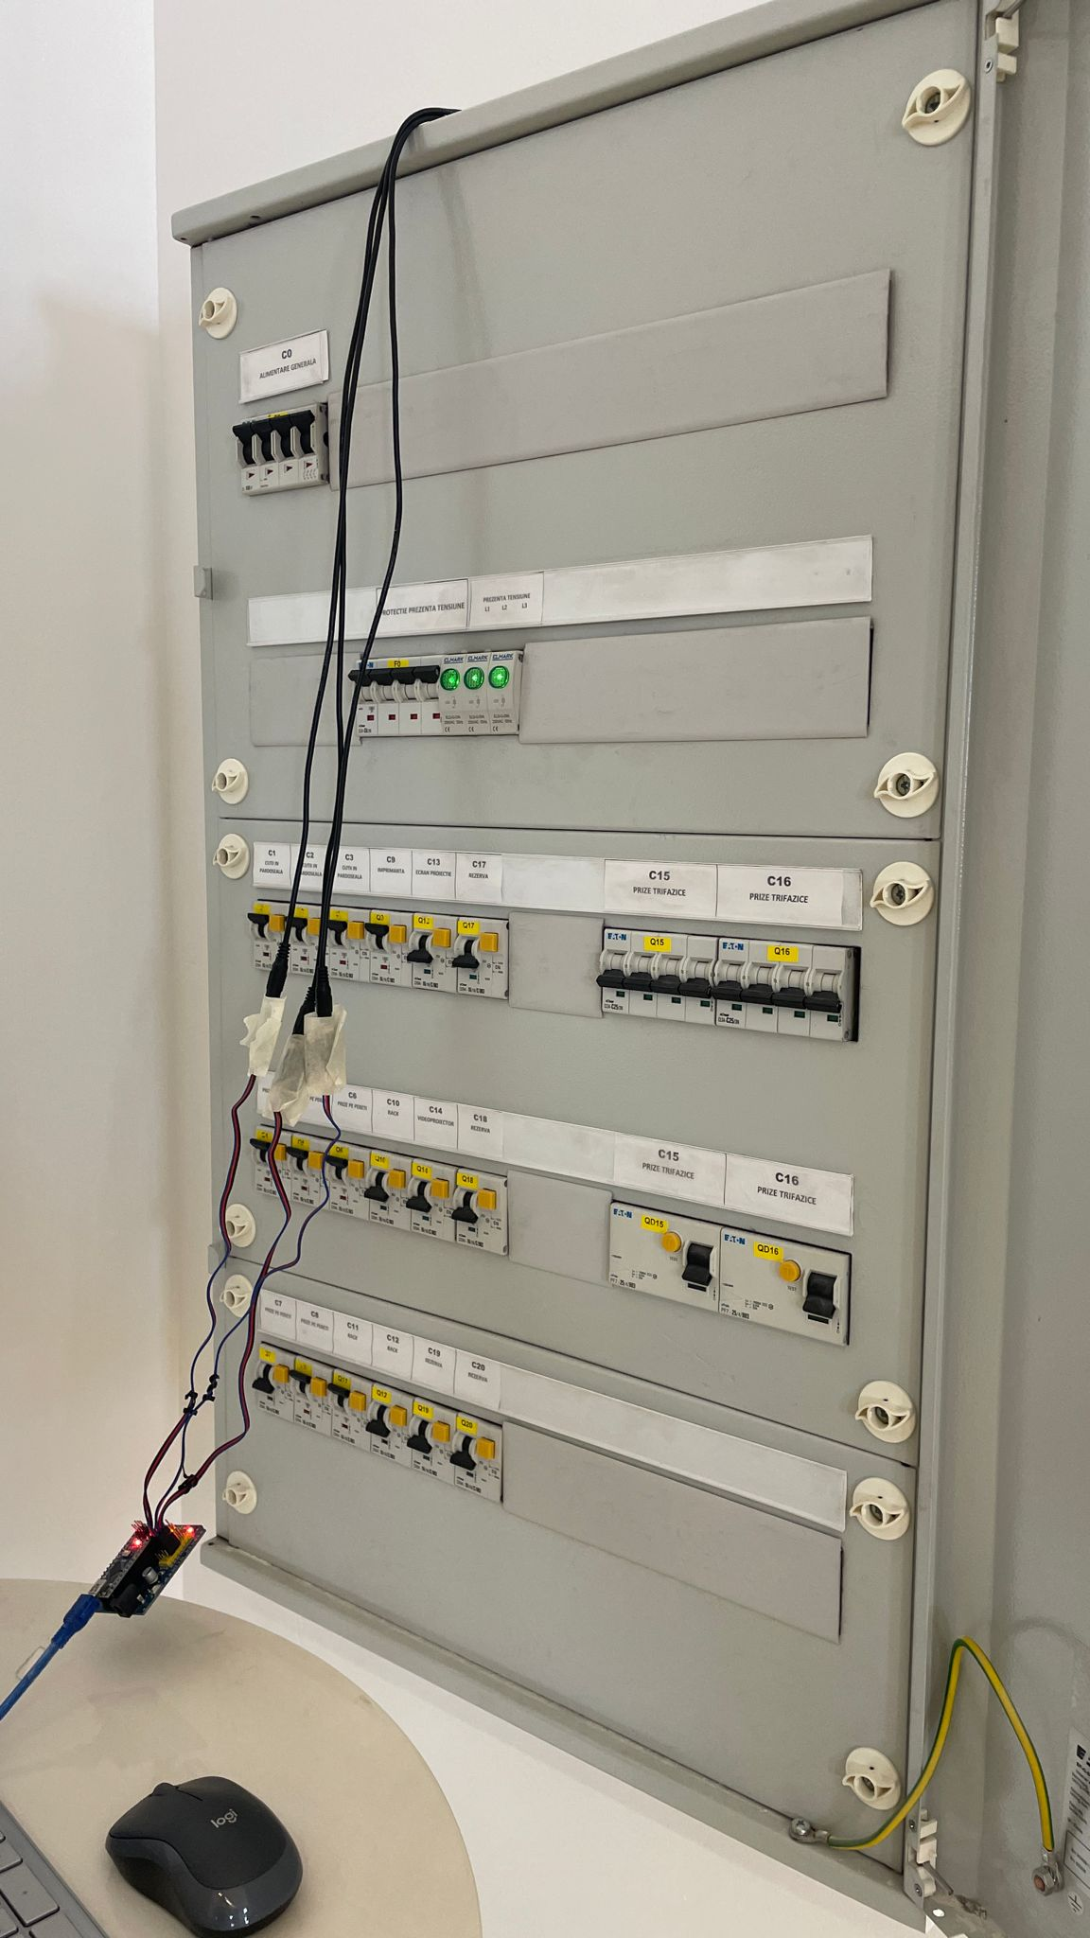
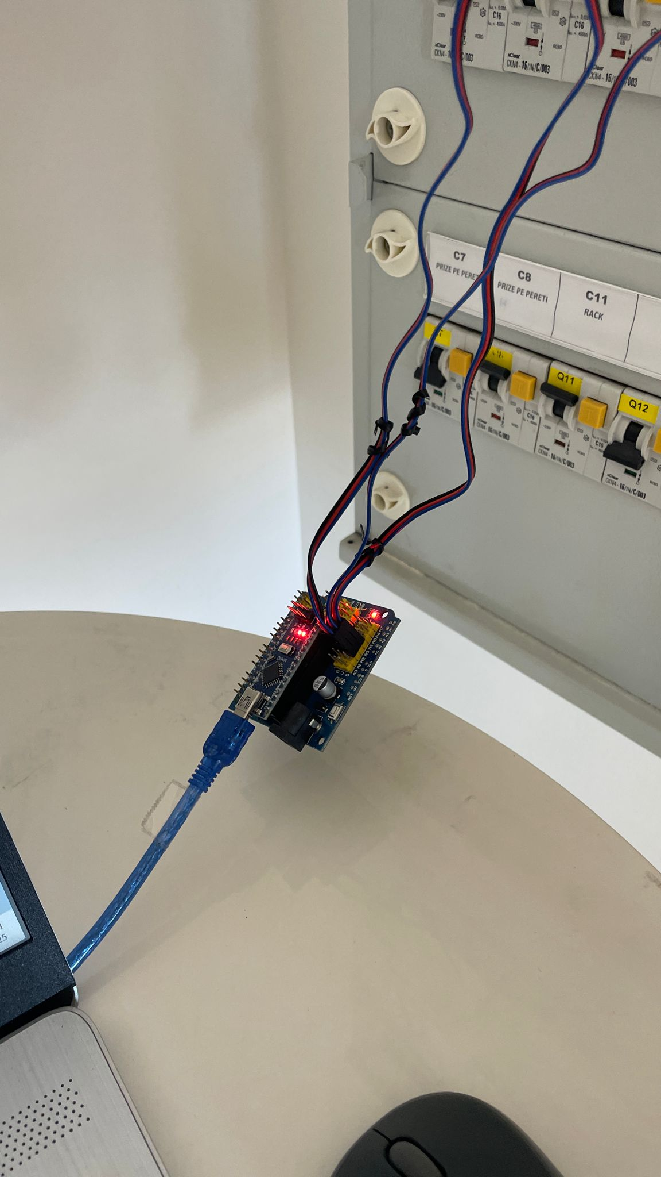
Thank you for your attention!
Starting a real-world use case for our Energy Monitoring System

